Slide 1
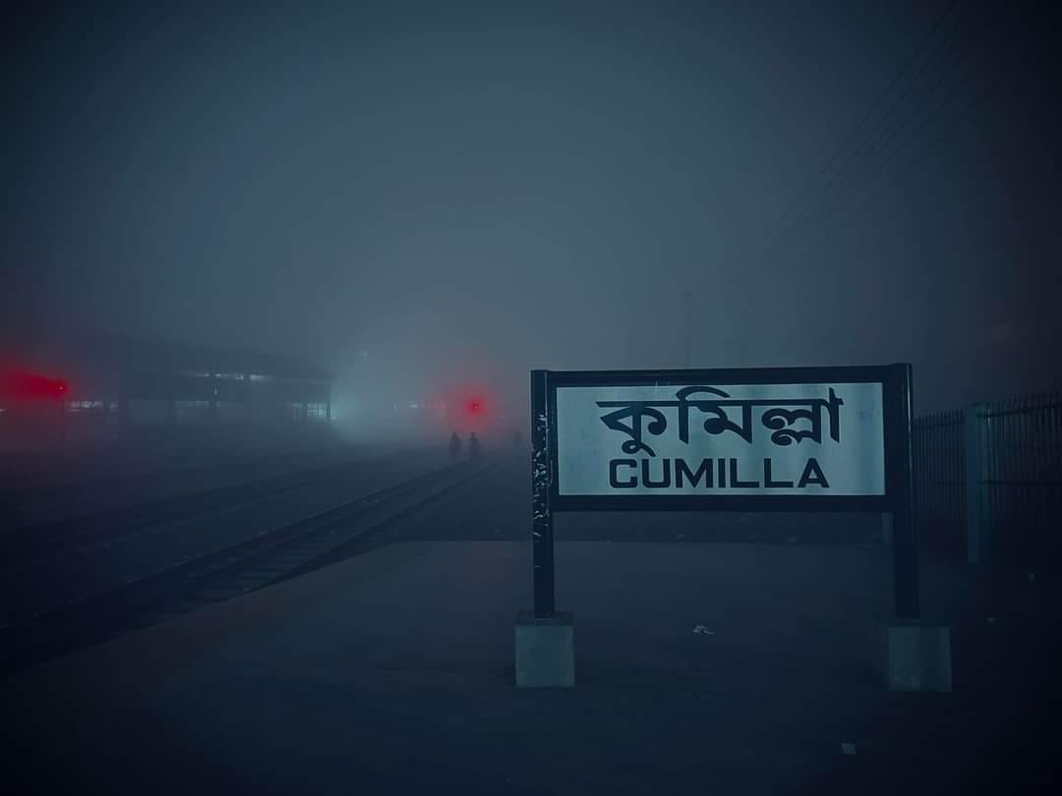
Cumilla District
A presentation by…..
A. F. M. RAFIUL HASSAN
22-47048-1

Slide 2
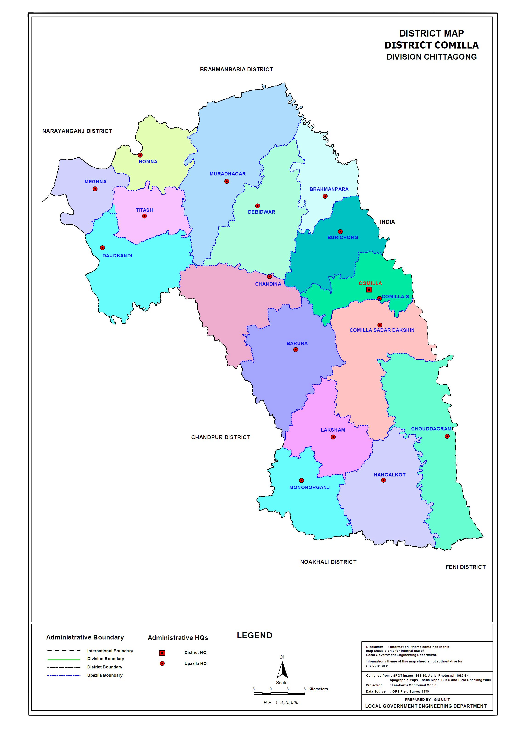
Cumilla :
The Land of Pride & Heritage
Cumilla is one of the largest and most prominent districts in Bangladesh situated 100km southeast of Dhaka city. This city is well connected to all other nearby and surrounding cities through roads and rail.
The district was a part of the kingdoms of the Pala and Chndrya dynasties and Samatat Janapada in ancient times. It had also been a renowned city of the Indian subcontinent during the colonial period. That's why the city is filled with heritage properties and considered as a hub for historical artifacts.

Slide 3
Administrative structure
Cumilla district consists of 17 upazilas, 1 City Corporation, 8 pourashavas and 185 unions.
Deputy Commissioner (DC):
- Mohammad Shamim Alam
Superintendent of Police (SP):
- Mr. Abdul Mannan
Mayor:
- Arfanul Haque Rifat

Slide 4
Population & Literacy Ratio
OTHERS
0.11%
Total Population: 5.17 Million
- Male: 2.47 Million
- Female: 2.7 MillQion
Literacy Rate:
- Cumilla’s literacy rate is 76.5 percent which is higher than the national average of 74.7 percent.
Religions:
- Islam: 95.10%
- Hinduism: 4.79%
- Others: 0.11%
HINDUISM
4.79%
ISLAM
95.10%

Slide 5


Political Leaders
Various politically powerful people hail from this cumilla divsion, like the Ex-president of Bangladesh Khondaker Mostaq Ahmad and the ex prime minister of Bangladesh Kazi Zafar Ahmed back in the late 1900s and there are also some powerful political leaders in the present and they're known as AKM Bahauddin Bahar who is the currently a member of parliament of Bangladesh.

Slide 6
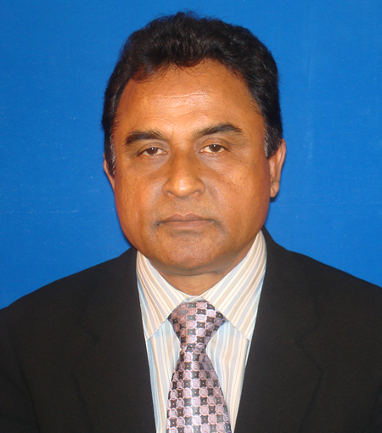
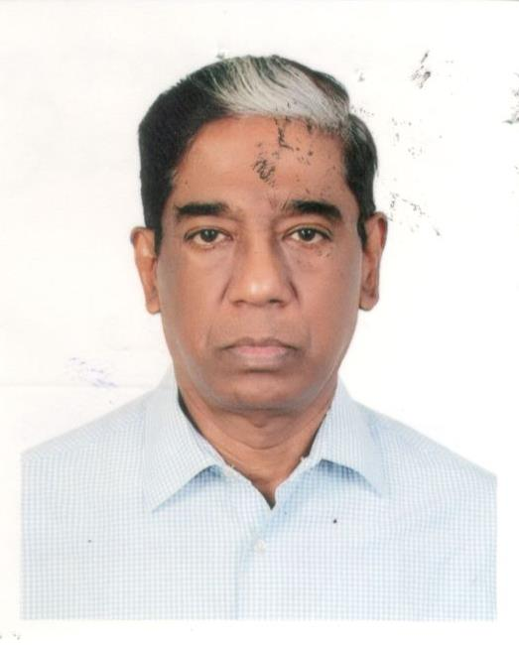
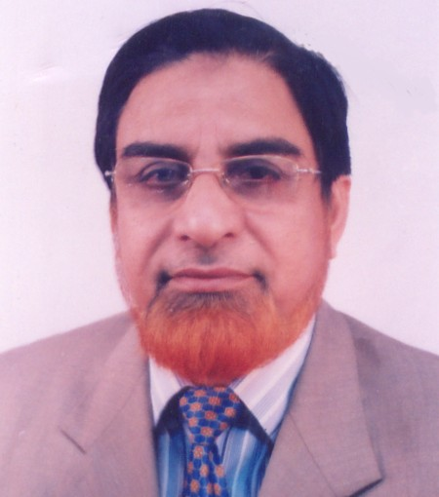
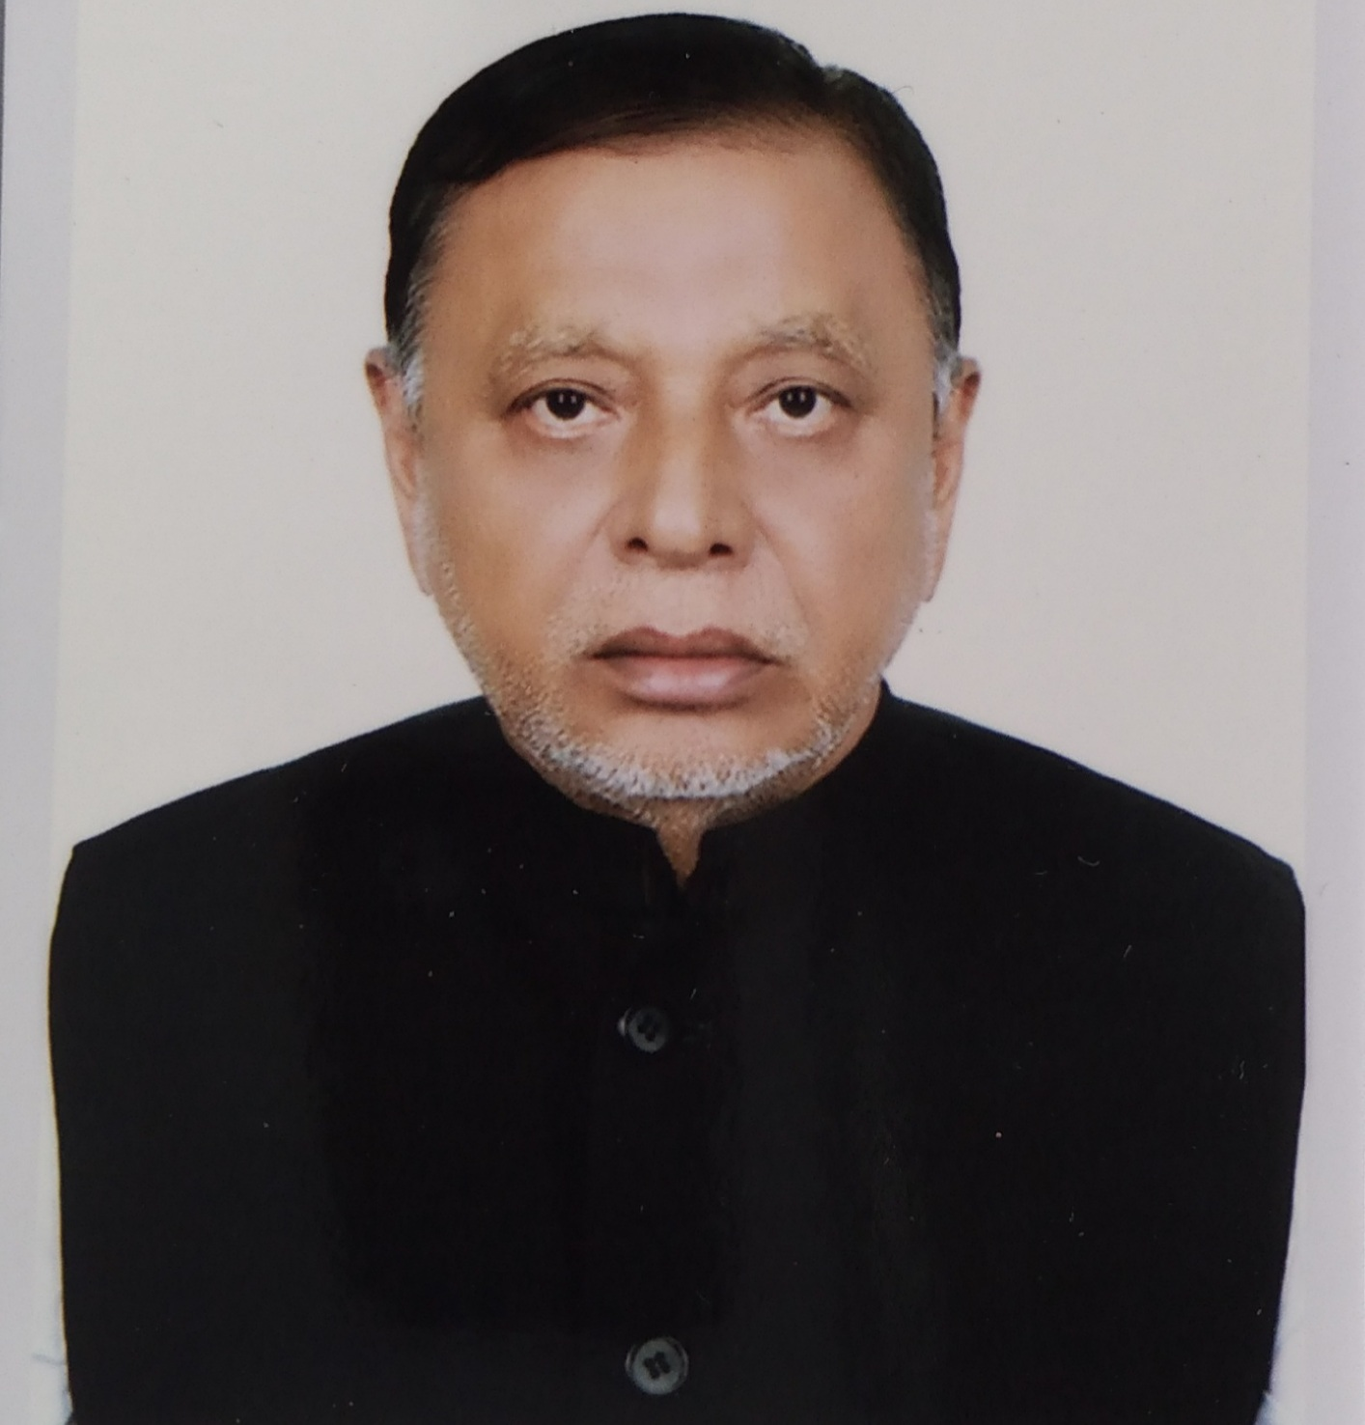
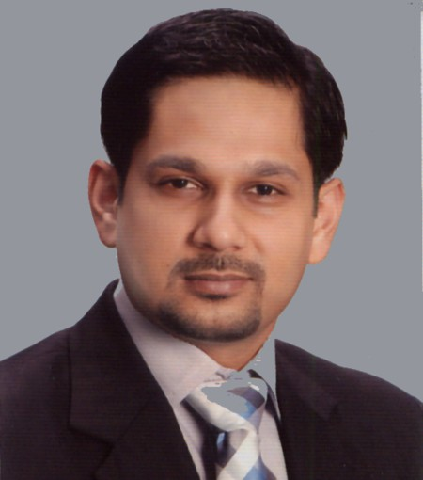
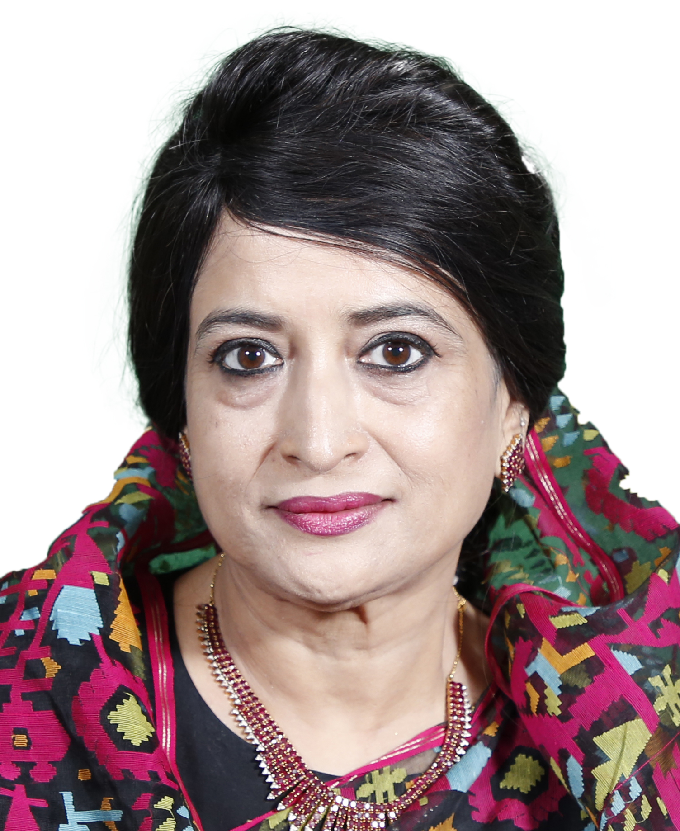
Member of parliament
A. H. M. Mustafa Kamal
- Cumilla-10
Pran Gopal Datta
- Cumilla-7
A. K. M. Bahauddin
- Cumilla-6
Abul Hashem Khan
- Cumilla-5
Razee Mohammad Fakhrul
- Cumilla-4
Selima Ahmad
- Cumilla-2

Slide 7
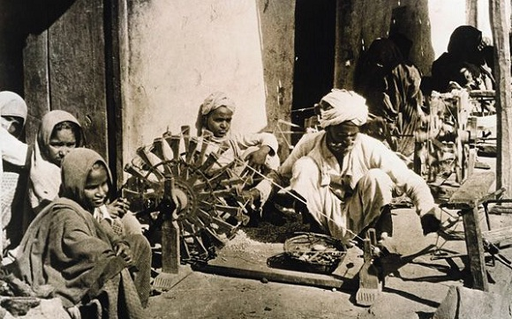
Economy
The Economic situation in Cumilla is pretty moderate and is better off than most other major cities in Bangladesh, which is evident in its well-off economy.
Cumilla's economy has flourished through trade and cottage industries, especially the ‘Khadi’ textile. which is famous all over the country. The production and trade of Khadi textiles have gained popularity throughout the country, contributing to the district's economic prosperity.
Lastly, Cumilla's economy benefits from its agricultural strength, export-oriented industries, and thriving trade and cottage industries.

Slide 8
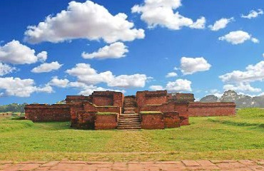
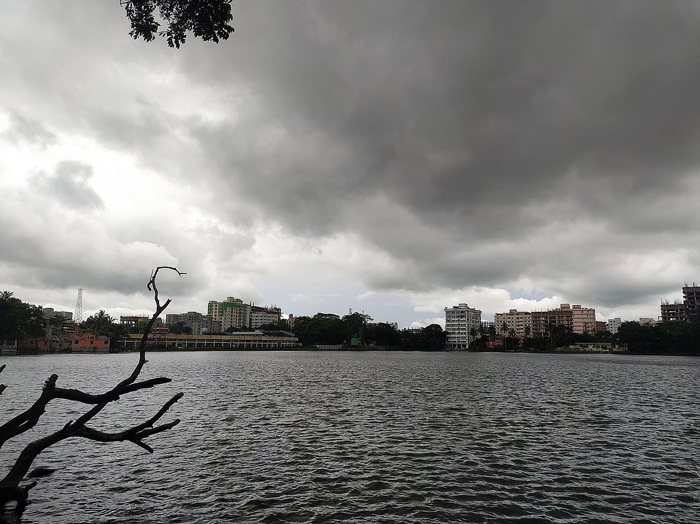
Archaeological site
Cumilla has no shortage of archaeological sties. They are the Comilla Jagannath Temple and Shalban Vihara which is in Moinamoti, these ruins are located in the middle of the Lalmai hills ridge and these ruins dates is so old that it dates back to the 7th century.
Shalban Vihara
- The ruins are in the middle of the Lalmai hills
ridge, and these are of a 7th-century
Dharmasagar
- The pond was dug by the Tripura king
Dharma Manikya I in 1458.

Slide 9
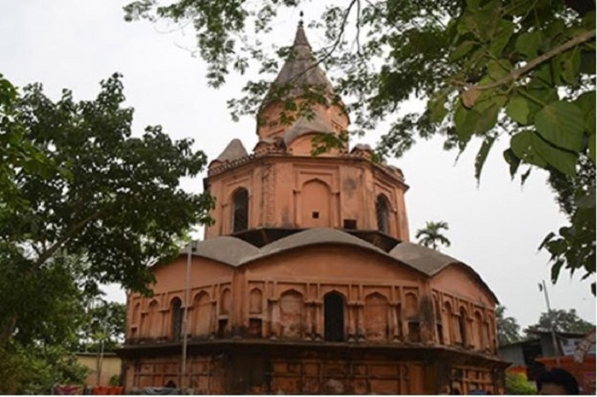
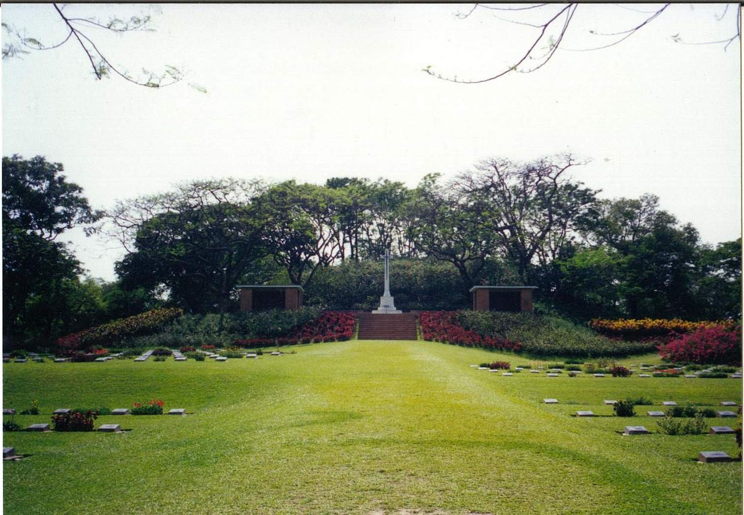
Archaeological site
Jagannath Temple
- It dates back to the early 18th
century and was built by Ratna
Manikya II.
Mainamati War Cemetery
- Second World War graves from nearby
areas. The cemetery contains 736
Commonwealth burials.

Slide 10
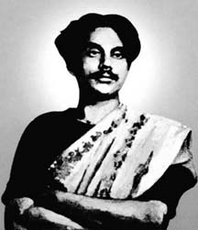
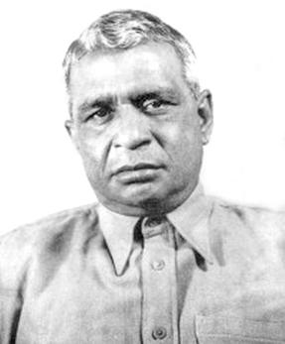
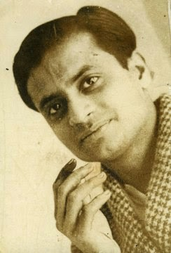
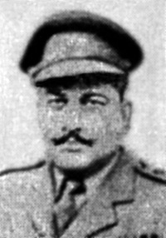
Renowned Personalities
Kazi Nazrul Islam
- National Poet of Bangladesh
Dhirendranath Datta
- A language activist and
politician
Buddhadeb Bosu
- One of the most reputed writers
in Bengali literature
Major Abdul Gani
- Bengali Muslim Military Officer
- Co-founder of East Bengal Regiment

Slide 11
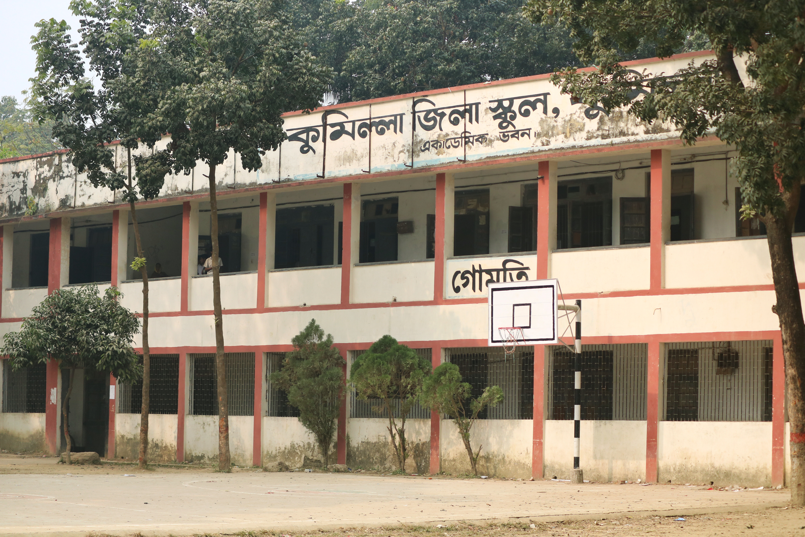
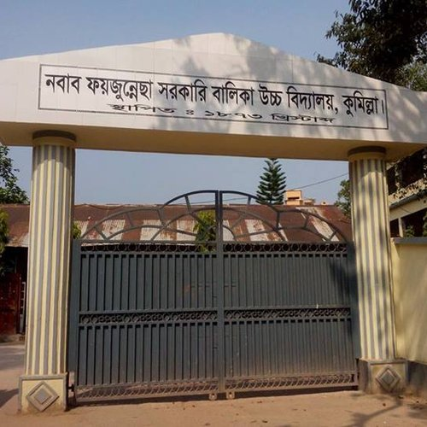
Renowned educational Institutions
Renowned Personalities
Cumilla Zilla School
- A renowned government boy’s school
- Established in 1837
Nawab Faizunnesa School
- A renowned government Girl’s school
- Founded in 1873

Slide 12
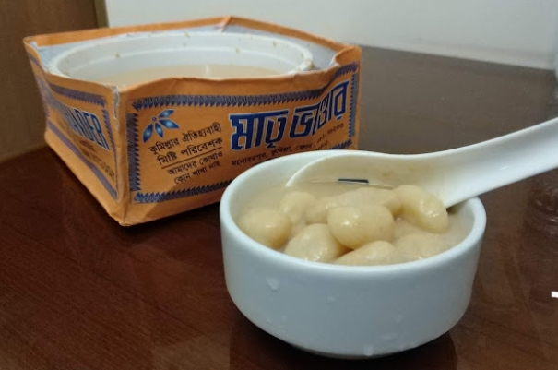
Traditional Food
Rasmalai of Cumilla
-This traditional dessert is very
popular and famous in Bangladesh.
Though Rasmalai / Rosmalai is made
in different places across the
country but Comilla's Rasmalai has
no comparison. The best of them is
the roshmalai of Comilla Matri -
Bhandar.

Slide 13

Conclusion
Being the land of pride and heritage as tagged by the government itself, Cumilla, in no way fails people to charm with its rich and diversified attributes in every aspect. The citizens here believe in harmony and so for ages peoples from different religions are living as a strong community. The district is a glorified name in history and continues to create remembrance till the day.

Slide 14

“THANK YOu”

